Slide 1



University Institute of Engineering
DEPARTMENT OF COMPUTER SCIENCE & ENGINEERING
Subject Name: Software Engineering
Subject Code: 23CST-206
Software Testing
DISCOVER . LEARN . EMPOWER

Slide 2
Chapter-7 Software Testing
Validation Testing
System Testing

Slide 3
Validation Testing
Validation testing begins at the culmination of integration testing, when individual components have been exercised, the software is completely assembled as a package, and interfacing errors have been uncovered and corrected.
Validation Testing ensures that the product actually meets the client's needs. It can also be defined as to demonstrate that the product fulfills its intended use when deployed on appropriate environment.
It answers to the question, Are we building the right product?

Slide 4
Validation Testing
Validation Testing, carried out by QA professionals, is to determine if the system complies with the requirements and performs functions for which it is intended and meets the organization’s goals and user needs.
Validation can be defined in many ways, but a simple definition is that validation succeeds when software functions in a manner that can be reasonably expected by the customer.

Slide 5
Validation Testing
Thus, to ensure customer satisfaction, developers apply validation testing.
Its goal is to validate and be confident about the product or system and that it fulfils the requirements given by the customer.
The acceptance of the software from the end customer is also its part.
If a Software Requirements Specification has been developed, it describes all user-visible attributes of the software and contains a Validation Criteria section that forms the basis for a validation-testing approach.

Slide 6
Validation-Test Criteria
Software validation is achieved through a series of tests that demonstrate conformity with requirements.
A test plan outlines the classes of tests to be conducted, and a test procedure defines specific test cases that are designed to ensure that all functional requirements are satisfied, all behavioral characteristics are achieved, all content is accurate and properly presented, all performance requirements are attained, documentation is correct, and usability and other requirements are met (e.g., transportability, compatibility, error recovery, maintainability).

Slide 7
After each validation test case has been conducted, one of two possible conditions exists:
(1) The function or performance characteristic conforms to specification and is accepted
(2) a deviation from specification is uncovered and a deficiency
list is created.
Deviations or errors discovered at this stage in a project can rarely be corrected prior to scheduled delivery. It is often necessary to negotiate with the customer to establish a method for resolving deficiencies.

Slide 8
Configuration Review
An important element of the validation process is a configuration review.
The intent of the review is to ensure that all elements of the software configuration have been properly developed, are cataloged, and have the necessary detail to bolster the support activities.
The configuration review, sometimes called an audit

Slide 9
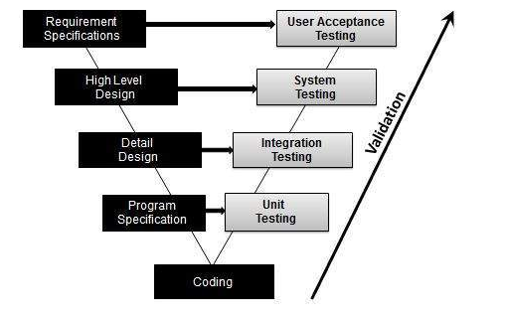
Validation Testing - Workflow
Validation testing can be best demonstrated using V-Model. The Software/product under test is evaluated during this type of testing.

Slide 10
Validation Testing Variations:
Alpha testing- The alpha test is conducted at the developer’s site by a representative group of end users. The software is used in a natural setting with the developer “looking over the shoulder” of the users and recording errors and usage problems. Alpha tests are conducted in a controlled environment.
Beta testing- The beta test is conducted at one or more end-user sites. Unlike alpha testing, the developer generally is not present. Therefore, the beta test is a “live” application of the software in an environment that cannot be controlled by the developer. The customer records all problems (real or imagined) that are encountered during beta testing and reports these to the developer at regular intervals. As a result of problems reported during beta tests, you make modifications and then prepare for release of the software product to the entire customer base.

Slide 11
Regression testing- This testing is done after the desired changes or modifications are made to the existing code. The code, when put to test, may have certain errors that can be resolved by making essential changes. The software is again put to test after these changes are made to check whether the new code fulfils customer requirements or not.

Slide 12
Stages of Validation testing Process
Validation Planning – To plan all the activities that need to be included while testing.
Define Requirements – To set goals and define the requirements for testing.
Selecting a Team – To select a skilled and knowledgeable development team (the third party included).
Developing Documents – To develop a user specification document describing the operating conditions.
Estimation/Evaluation – To evaluate the software as per the specifications and submit a validation report.
Fixing bugs or Incorporating Changes – To change the software so as to remove any errors found during evaluation.

Slide 13
System Testing
System Testing is a type of software testing that is performed on a complete integrated system to evaluate the compliance of the system with the corresponding requirements.
In system testing, integration testing passed components are taken as input.
The goal of integration testing is to detect any irregularity between the units that are integrated together.
System testing detects defects within both the integrated units and the whole system. The result of system testing is the observed behavior of a component or a system when it is tested.

Slide 14
System Testing
System Testing is carried out on the whole system in the context of either system requirement specifications or functional requirement specifications or in the context of both.
System testing tests the design and behavior of the system and also the expectations of the customer. It is performed to test the system beyond the bounds mentioned in the software requirements specification (SRS).
System Testing is basically performed by a testing team that is independent of the development team that helps to test the quality of the system impartial. It has both functional and non-functional testing.
System Testing is a black-box testing.

Slide 15
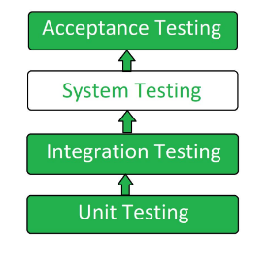
System Testing
System Testing is performed after the integration testing and before the acceptance testing.

Slide 16
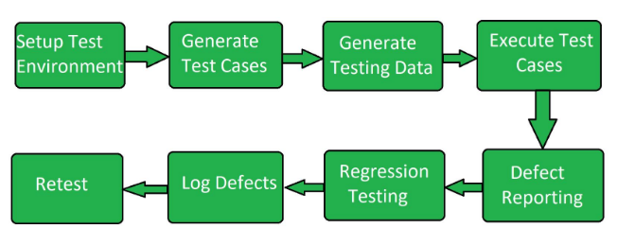
System Testing Process

Slide 17
System Testing Process
Test Environment Setup: Create testing environment for the better quality testing.
Create Test Case: Generate test case for the testing process.
Create Test Data: Generate the data that is to be tested.
Execute Test Case: After the generation of the test case and the test data, test cases are executed.

Slide 18
System Testing Process
Defect Reporting: Defects in the system are detected.
Regression Testing: It is carried out to test the side effects of the testing process.
Log Defects: Defects are fixed in this step.
Retest: If the test is not successful then again test is performed.

Slide 19
Types of System Testing
1. Recovery testing
Recovery testing is a system test that forces the software to fail in a variety of ways and verifies that recovery is properly performed. If recovery is automatic (performed by the system itself), reinitialization, checkpointing mechanisms, data recovery, and restart are evaluated for correctness. If recovery requires human intervention, the mean-time-to-repair (MTTR) is evaluated to determine whether it is within acceptable limits.

Slide 20

2. Security Testing
Security testing attempts to verify that protection mechanisms built into a system will, in fact, protect it from improper penetration.
During security testing, the tester plays the role(s) of the individual who desires to penetrate the system. Anything goes! The tester may attempt to acquire passwords through external clerical means; may attack the system with custom software designed to break down any defences that have been constructed; may overwhelm the system, thereby denying service to others; may purposely cause system errors, hoping to penetrate during recovery; may browse through insecure data, hoping to find the key to system entry.

Slide 21
3. Stress Testing
Stress testing executes a system in a manner that demands resources in abnormal quantity, frequency, or volume.
For example, (1) special tests may be designed that generate ten interrupts per second, when one or two is the average rate,
(2) input data rates may be increased by an order of magnitude to determine how input functions will respond,
(3) test cases that require maximum memory or other resources are executed,
(4) test cases that may cause thrashing in a virtual operating system are designed,
(5) test cases that may cause excessive hunting for disk-resident data are created. Essentially, the tester attempts to break the program.

Slide 22
4.Performance Testing
Performance testing is designed to test the run-time performance of software within the context of an integrated system. Performance testing occurs throughout all steps in the testing process.
Even at the unit level, the performance of an individual module may assessed as tests are conducted. However, it is not until all system elements are fully integrated that the true performance of a system can be ascertained.
Performance tests are often coupled with stress testing and usually require both hardware and software instrumentation.

Slide 23
5. Deployment Testing
Deployment testing, sometimes called configuration testing, exercises the software in each environment in which it is to operate.
In addition, deployment testing examines all installation procedures and specialized installation software (e.g., “installers”) that will be used by customers, and all documentation that will be used to introduce the software to end users.

Slide 24
References
https://www.guru99.com/system-testing.html#:~:text=SYSTEM%20TESTING%20is%20a%20level,a%20larger%20computer%2Dbased%20system.
https://www.geeksforgeeks.org/system-testing/
https://www.tutorialspoint.com/software_testing_dictionary/validation_testing.htm#:~:text=Software%20Testing%20%2D%20Validation%20Testing,actually%20meets%20the%20client's%20needs.
https://www.javatpoint.com/verification-and-validation-testing

Slide 25
THANK YOU

